Slide 1


Disentangling how selection, demography, and sex-biased behavior influence genetic diversity using field study–informed genetic simulations
1
Timothé Dandoy
Notes:
Internship
Title
Intro Pi

Slide 2
I. Introduction
2
Notes:
Internship
Title
Intro Pi

Slide 3
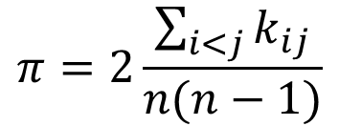
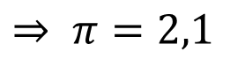
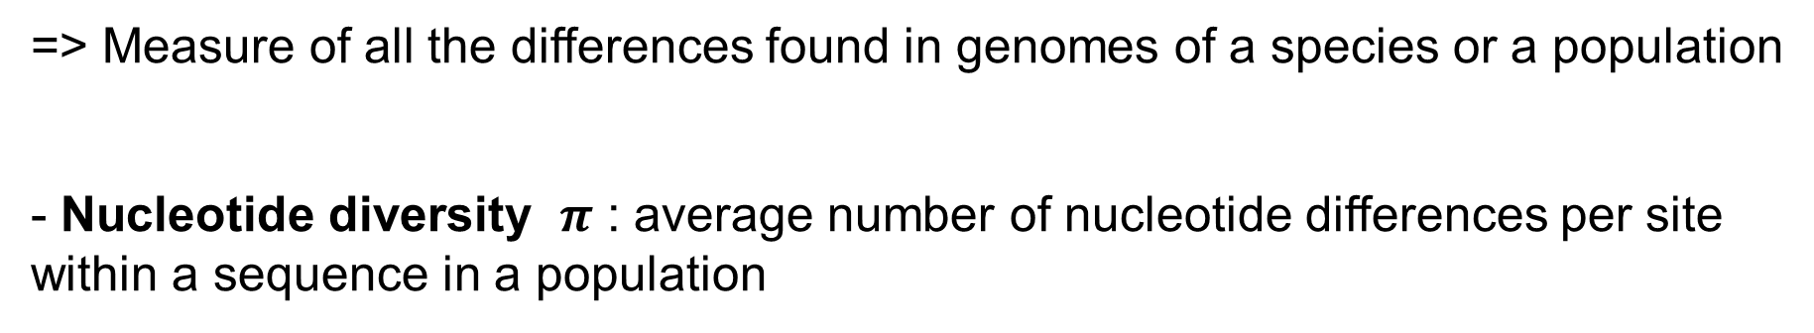
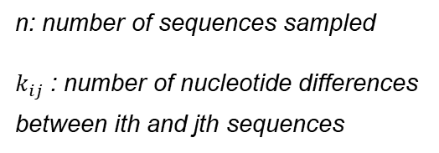
Genetic Diversity
=> Measure of all the differences found in genomes of a species or a population
- Nucleotide diversity $π$ : average number of nucleotide differences per site within a sequence in a population
$$π=2\frac{\sum_{i<j}{k_{ij}}}{n(n−1)}$$
A C G T A A C T T C T C G G A C A T A T G A C G T A A C T T C T C G G A C A A A T G A C G C A A C T A C T C G G A C A T A T G A C G T A A C T A C T C G G A C A T A T G A C G T A A C T A C T C G C A C A G A T G
n: number of sequences sampled
$k_{ij}$: number of nucleotide differences between ith and jth sequences
T / C
T / A
G / C
T / A / G
$$⇒ π=2,1$$
Molecular Population Genetics, Hahn (2019)
3
Notes:
Def
Estimator : Nucleotide Diversity
-> Nucleotide differences between sequences

Slide 4
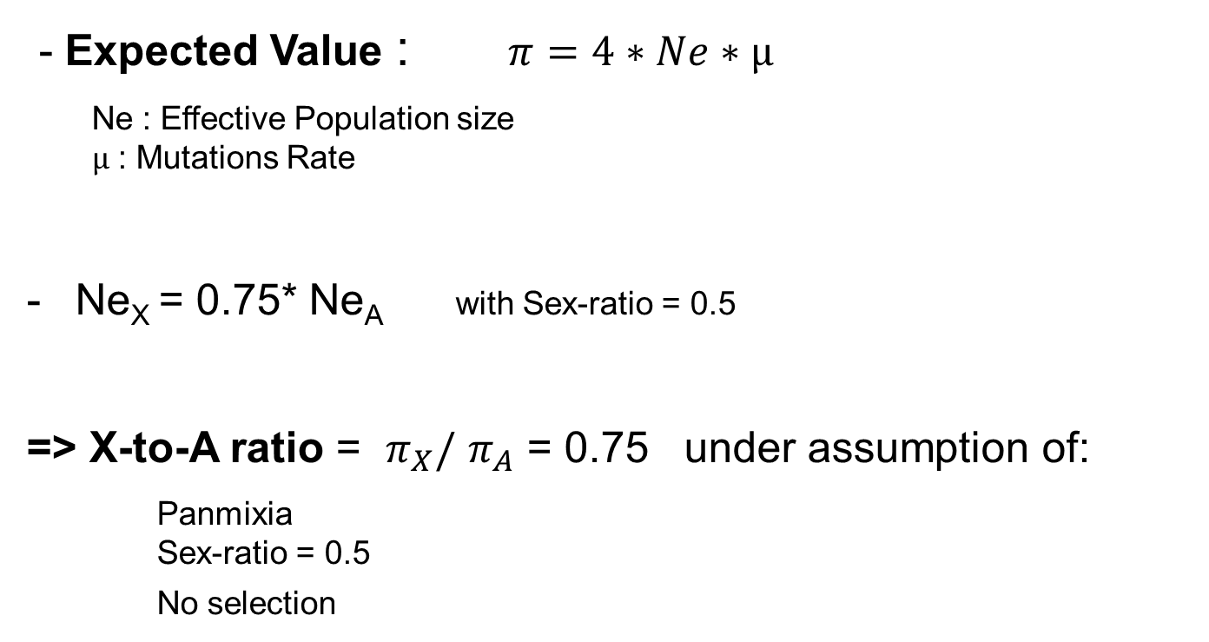
Genetic Diversity
- Expected Value : $π=4∗Ne∗µ$
Ne : Effective Population size $µ$ : Mutations Rate
Ne_{X} = 0.75* Ne_{A} with Sex-ratio = 0.5
=> X-to-A ratio = $π_{X}/$ $π_{A}$ = 0.75 under assumption of:
Panmixia Sex-ratio = 0.5 No selection
Molecular Population Genetics, Hahn (2019)
4
Notes:
Formulas True if panmixia and no selection
Some forces may impact the ratio

Slide 5
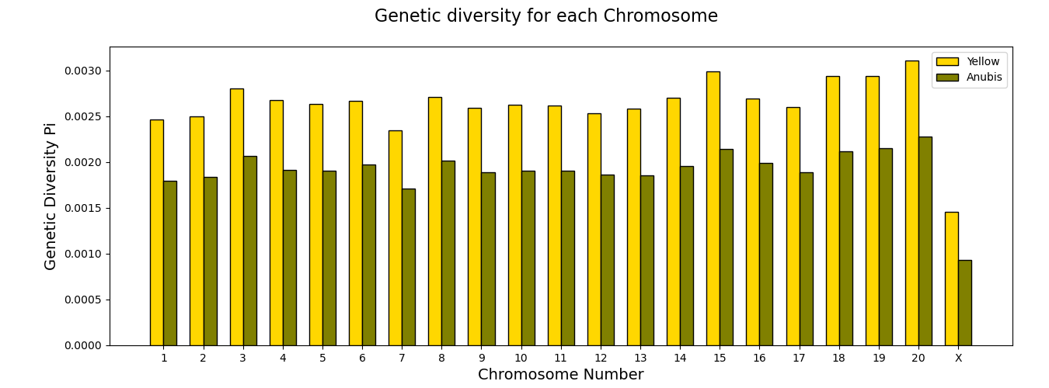
Genetic Diversity in Baboons
=> The X-to-A genetic ratio is below the expectation
5
Notes:
All primates have low ratio
PiX / PiChromosome
Always below the expectation
Forces exist that change the ratio

Slide 6
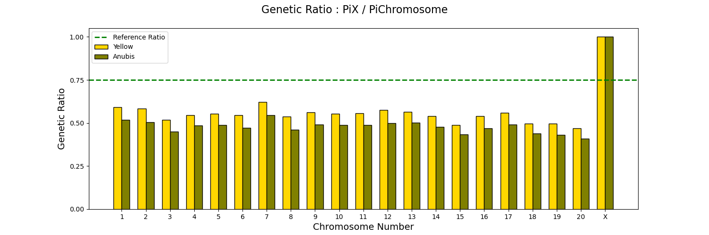
Genetic X-to-A Ratio in Baboons
=> The X-to-A genetic ratio is below the expectation
6
Notes:
All primates have low ratio
PiX / PiChromosome
Always below the expectation
Forces exist that change the ratio

Slide 7
What forces or processus may influence the X-to-A ratio of a population ?
7

Slide 8
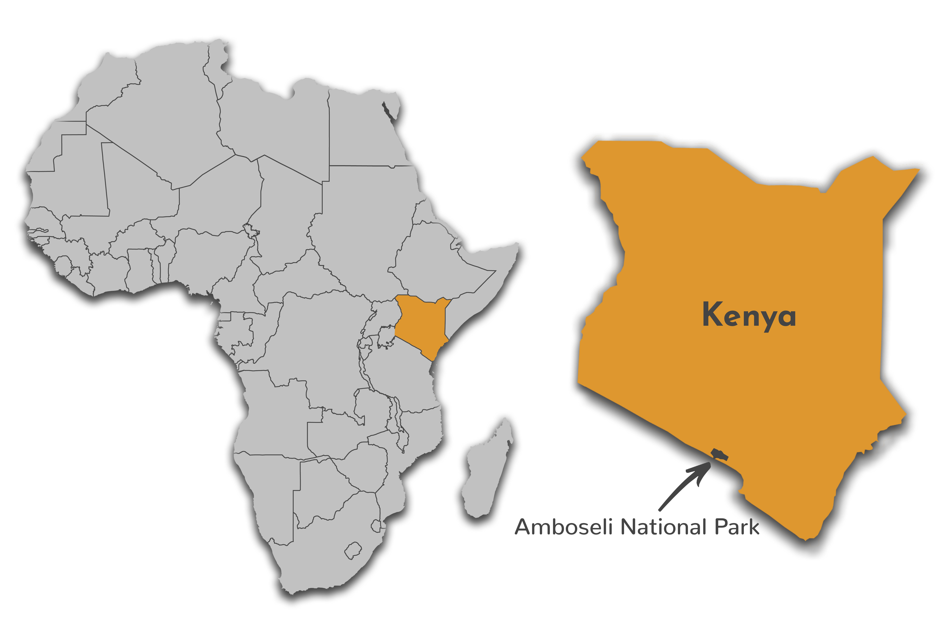
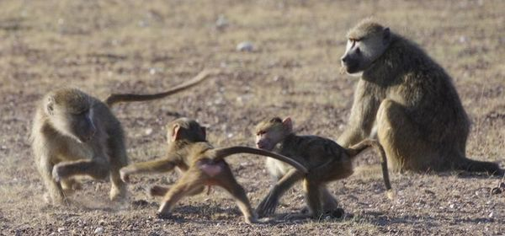
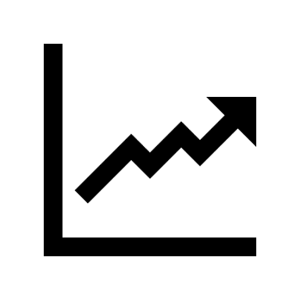

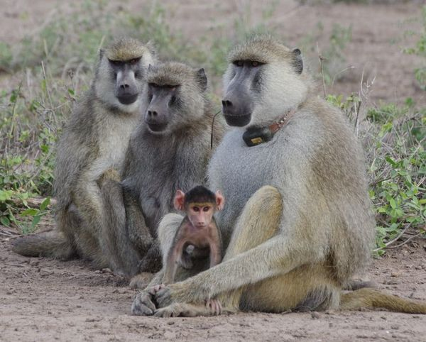
Amboseli Baboon Data
Amboseli Baboons (Papio cynocephalus)
Safaripedia.com
Demographic and Behavioral Data
Genetic Data
Elizabeth Archie’s photo
The Amboseli Baboon Research Project: 40 Years of Continuity and Change, Alberts & Altmann (2012)
8
Elizabeth Archie’s photo
Notes:
Data have been collected for 50 Years
Two type of Data :
Use data two find what forces may influence the ratio,
And compute them on simulations

Slide 9



Sex-biased behaviors
Reproductive Tactics of Male Savanna Baboons, Noë & Sluijter (1990)
Differential impact on the Autosomal (A) diversity and the Chromosome X diversity
Ex Males Reproductive Skew:
RANK
AA / XY
AA / XY
AA / XY
AA / XY
Reproduction
=> The X-to-A genetic ratio increases
9
Notes:
Sex biased bahaviors
Difference between males and females
Differences of impact between X and A
We study 2 forces
RepSkew :
Differential reproductive success
Based on ranking
A male that do not reproduce loose 2A for 1 X
Ratio increases

Slide 10
Sex-biased behaviors
Balancing Costs and Opportunities: Dispersal in Male Baboons, Alberts & Altmann (1995)
Differential impact on the Autosomal (A) diversity and the Chromosome X diversity
Ex Male-Only Migration:
AA / XY
Sub-Pop 1
Sub-Pop 2
=> The X-to-A genetic ratio decreases
10
Notes:
Males only migrations:
In baboons only the males migrate
Leave their population when adult
May migrate severeal times
In the new subpop, 2A for 1X arrives
Ratio decreases

Slide 11

Sex-biased Process
The Amboseli Baboon Research Project: 40 Years of Continuity and Change, Alberts & Altmann (2012)
Differential impact on the Autosomal (A) diversity and the Chromosome X diversity
Ex Hybridization :
AA / XY
Anubis Baboon
Amboseli
=> The X-to-A genetic ratio decreases
11
Notes:
Males only migrations:
In baboons only the males migrate
Leave their population when adult
May migrate severeal times
In the new subpop, 2A for 1X arrives
Ratio decreases

Slide 12
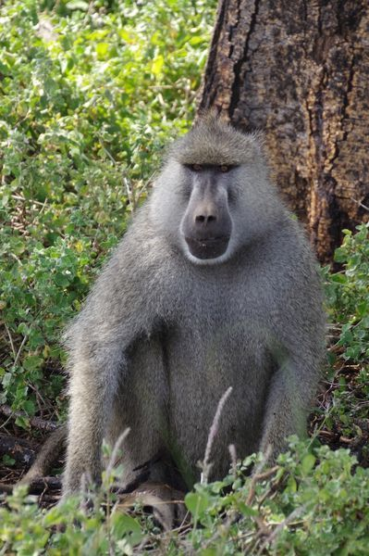
Genetic Forces
Selection
Haploidy of X in males
Hybridization between Anubis and Yellow baboons
Haldane’s Rule : reproduction and hybridization incompatibilities accumulate faster on X
=> Stronger selection effect on the X Chromosome than on the Autosomes
Amboseli Baboon
Comparative studies on speciation: 30 years since Coyne and Orr, Matute & Cooper (2021)
Elizabeth Archie’s photo
=> The X-to-A genetic ratio decreases
12

Slide 13
Objectives
Computational Simulations to model :
- Reproductive Skew in Males
- Male-Only Migration
- Hybridization
- Selection
}
Sex-biased
13

Slide 14
Objectives
Assess the strength of each forces on the X-to-A ratio
Determine if sex-biased processes enough for explaining the difference in genetic diversity between the X and the autosomes, or whether instead we need to invoke natural selection
14
Notes:
2 Problematics
Use of SLiM

Slide 15
II. Methods
15
Notes:
Internship
Title
Intro Pi

Slide 16
A. SLiM Presentation
16
Notes:
Internship
Title
Intro Pi

Slide 17
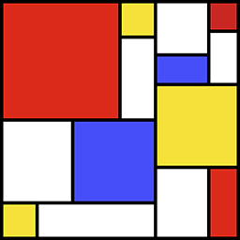

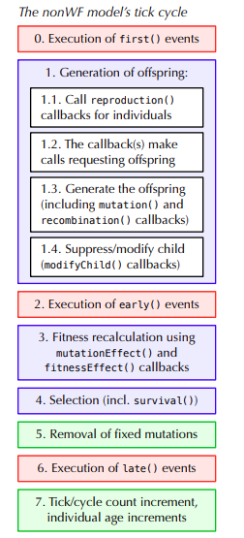
SLiM Presentation
Evolutionary simulation framework that combines a powerful engine for population genetic simulations with the capability of modeling arbitrarily complex evolutionary scenarios => Forward simulation of both Dynamics and Genetics of the population
Simulations through the Ticks (1 Tick = 1 Year)
Each individual -> 1 pair of A + 1 pair of sex-chromosomes
17
SLiM Manual

Slide 18
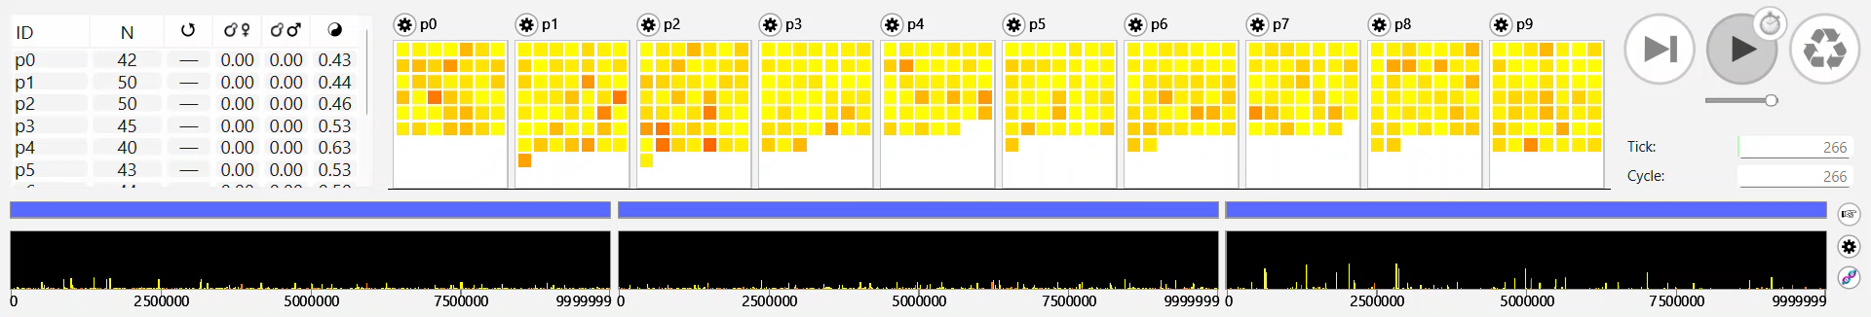
SLiM Presentation
500 individuals 10 subpopulations Chromosomes length = 1e7 Mutations Rates = 1,25e-8
Populations size
Sex ratio
Subpopulations
Individuals
Ticks
Mutations frequencies
Autosomes
X Chromosomes
Y Chromosomes
18

Slide 19
B. Reference Models
19
Notes:
Internship
Title
Intro Pi

Slide 20
Reference Models
Global Parameters:
- Population size : 750 Individuals - Sex Ratio : 0,5 (male proportion) - 1 Offsprings per Reproduction
- 1 pair of Autosomes and 1 pair of sex Chromosomes - Chromosomes Length : 1e8 nucleotides - Mutations Rate : 5e-7 mut.nuceotide⁻¹.tick⁻¹ - Only Neutral Mutations - Recombination Rate : 4e-7 recomb.chr⁻¹.gamete⁻¹.tick⁻¹
- Simulations Time : 2e4 Ticks
SLiM Manual
20

Slide 21

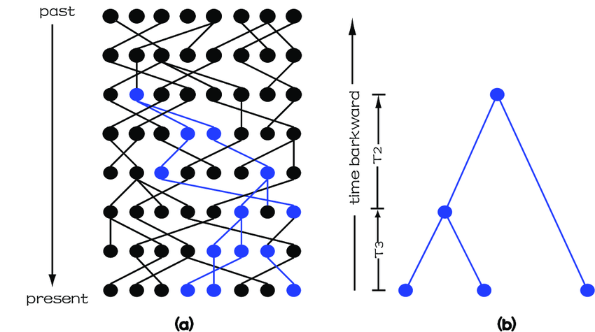
AGE
AGE
AGE

Slide 22
Reference Models
Wright-Fisher Model (WF)
Non-Overlapping generations
Constant Population Size, Constant Sex Ratio
Random mating between a male and a female
No selection
Liu, Xiaomo (2005)
21

Slide 23
Reference Models
Non-Wright-Fisher Models (NWF) :
-> Overlapping generations => Individuals may survive multiple years
-> 3 different Reproduction Systems :
-> Average Population Size and average Sex Ratio are constant => Carrying Capacity
22

Slide 24
Reference Models
Non-Wright-Fisher Models (NWF) :
-> Non-Overlapping generations => Individuals may survive multiple years
-> 3 different Reproduction Systems :
-> Average Population Size and average Sex Ratio are constant => Carrying Capacity
NWF Vanilla (NWF_V):
22

Slide 25
Reference Models
Non-Wright-Fisher Models (NWF) :
-> Non-Overlapping generations => Individuals may survive multiple years
-> 3 different Reproduction Systems :
-> Average Population Size and average Sex Ratio are constant => Carrying Capacity
NWF Vanilla (NWF_V):
Each Year,
- Formations of male-female couple
=> males and females reproduce once a year in maximum
22

Slide 26
Reference Models
Non-Wright-Fisher Models (NWF) :
-> Non-Overlapping generations => Individuals may survive multiple years
-> 3 different Reproduction Systems :
-> Average Population Size and average Sex Ratio are constant => Carrying Capacity
NWF Vanilla (NWF_V):
Each Year,
- Formations of male-female couple
=> males and females reproduce once a year in maximum
NWF Female Choice (NWF_FC):
22

Slide 27
Reference Models
Non-Wright-Fisher Models (NWF) :
-> Non-Overlapping generations => Individuals may survive multiple years
-> 3 different Reproduction Systems :
-> Average Population Size and average Sex Ratio are constant => Carrying Capacity
NWF Vanilla (NWF_V):
Each Year,
- Formations of male-female couple
=> males and females reproduce once a year in maximum
NWF Female Choice (NWF_FC):
- All female reproduce once a year
- They choose their male randomly among the population
=> males can reproduce several times a year
22

Slide 28
Reference Models
Non-Wright-Fisher Models (NWF) :
-> Non-Overlapping generations => Individuals may survive multiple years
-> 3 different Reproduction Systems :
-> Average Population Size and average Sex Ratio are constant => Carrying Capacity
NWF Vanilla (NWF_V):
Each Year,
- Formations of male-female couple
=> males and females reproduce once a year in maximum
NWF Female Choice (NWF_FC):
- All female reproduce once a year
- They choose their male randomly among the population
=> males can reproduce several times a year
NWF Life Table (NWF_LT):
AGE
22

Slide 29
Reference Models
Non-Wright-Fisher Models (NWF) :
-> Non-Overlapping generations => Individuals may survive multiple years
-> 3 different Reproduction Systems :
-> Average Population Size and average Sex Ratio are constant => Carrying Capacity
NWF Vanilla (NWF_V):
Each Year,
- Formations of male-female couple
=> males and females reproduce once a year in maximum
NWF Female Choice (NWF_FC):
- All female reproduce once a year
- They choose their male randomly among the population
=> males can reproduce several times a year
NWF Life Table (NWF_LT):
Same as Female Choice, except the addition of an age structure:
- a mortality table (♂ & ♀)
- a fertility table (♀)
=> female may not reproduce every years
AGE
22

Slide 30
C. Models Validation
23
Notes:
Internship
Title
Intro Pi

Slide 31
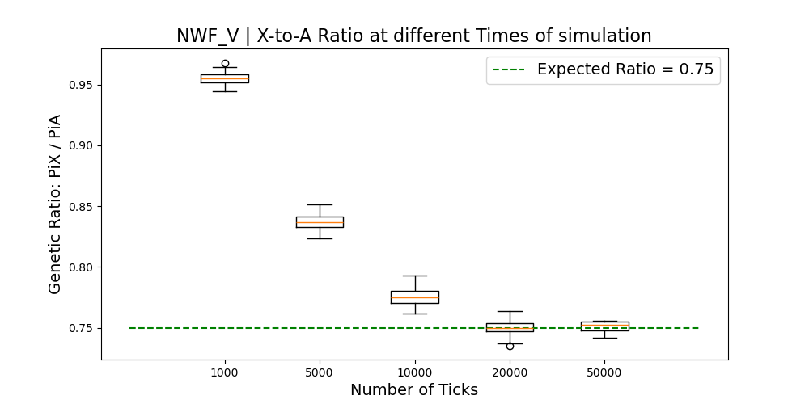
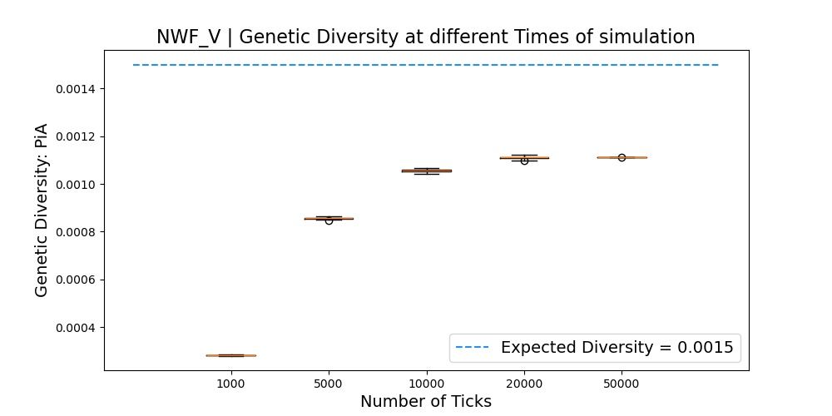
Burn-in Period NWF_V
=> Simulations must last 20000 Ticks
24

Slide 32
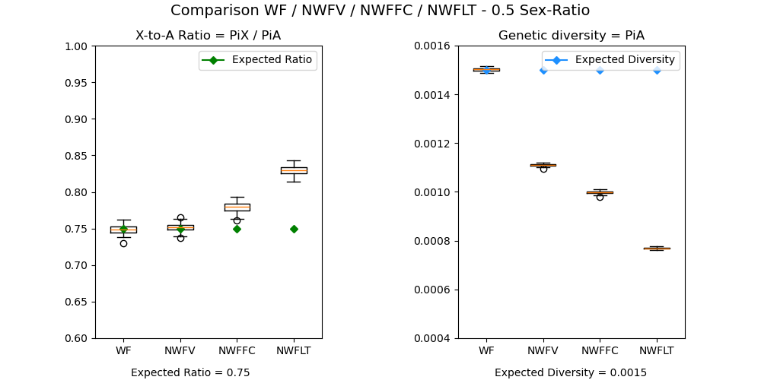
Diversity Estimations
AGE
25

Slide 33
Diversity Estimations
AGE
=> Genetic Diversity is reduced in NWF models
25

Slide 34
Diversity Estimations
AGE
=> Higer ratio for NWF_FC and NWF_LT ?
25

Slide 35
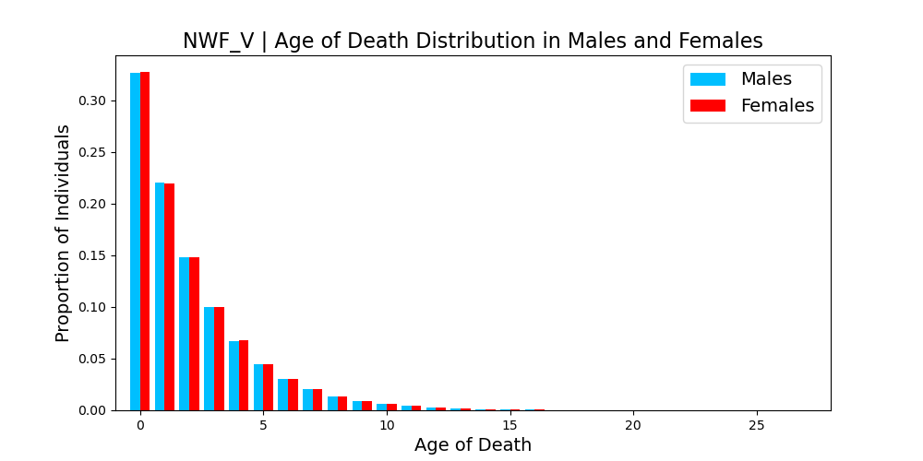
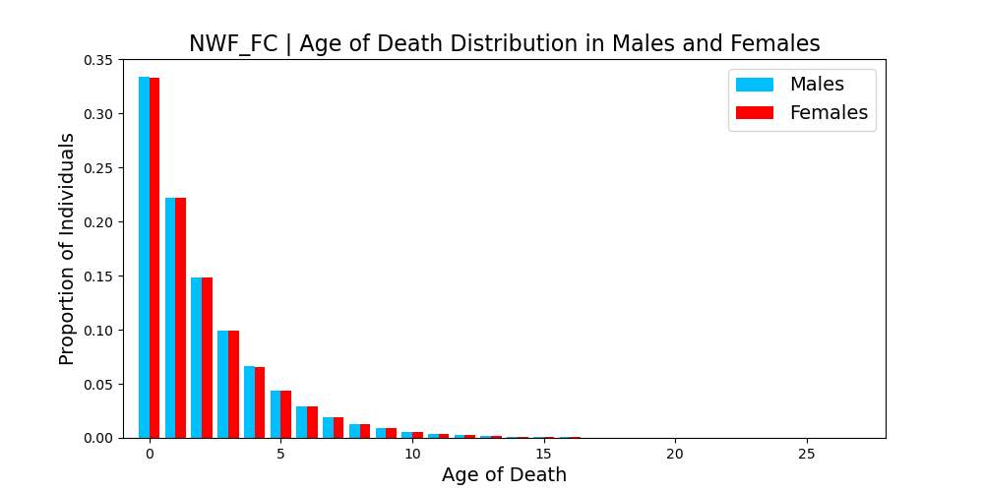
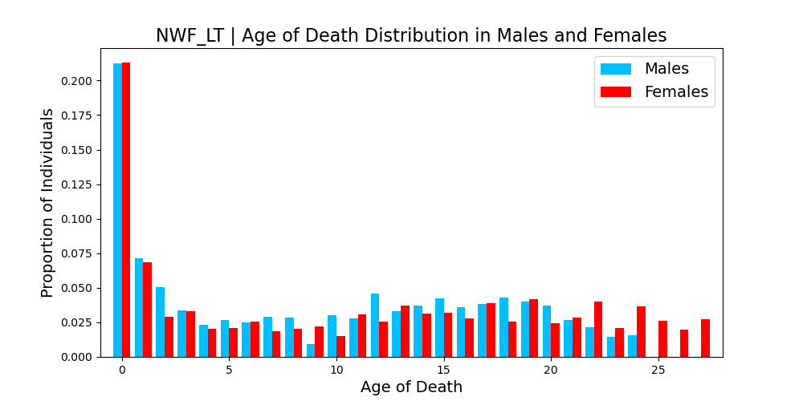
Age of Death
26
AGE

Slide 36
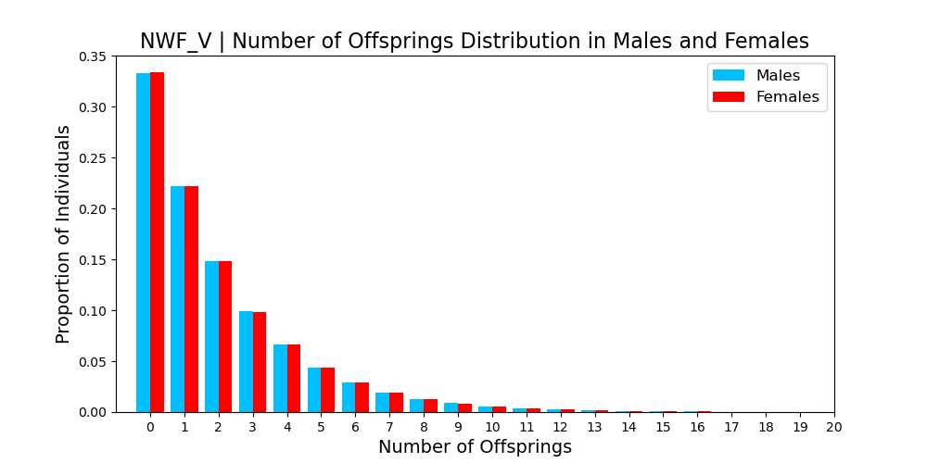
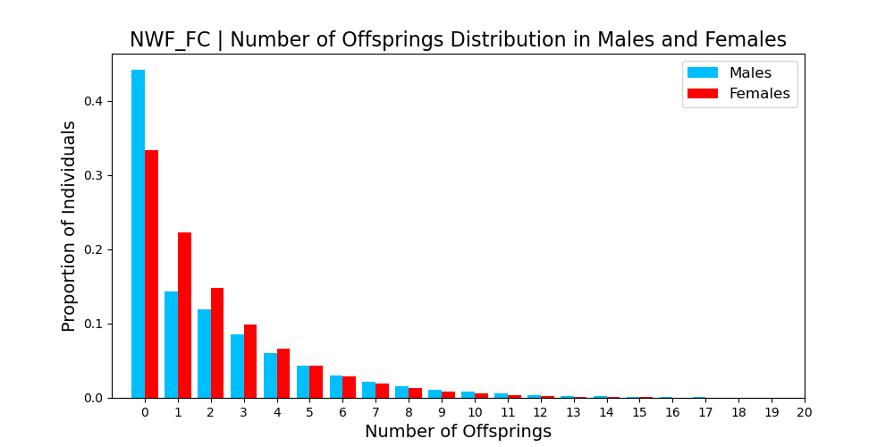
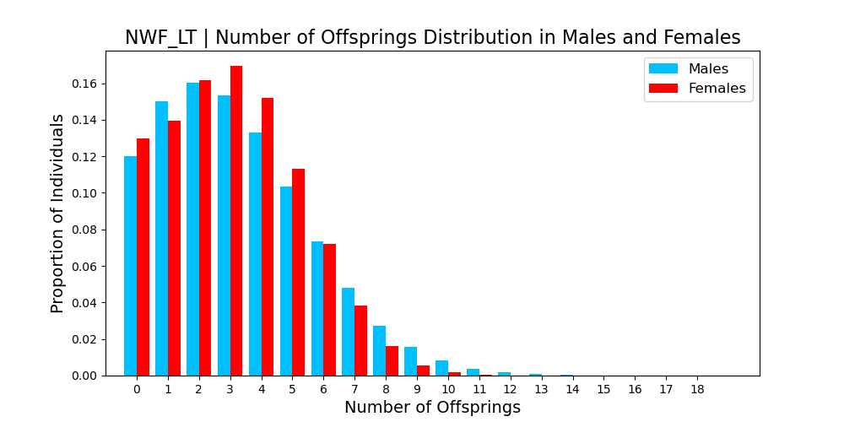
Number of Offsprings
27
AGE

Slide 37
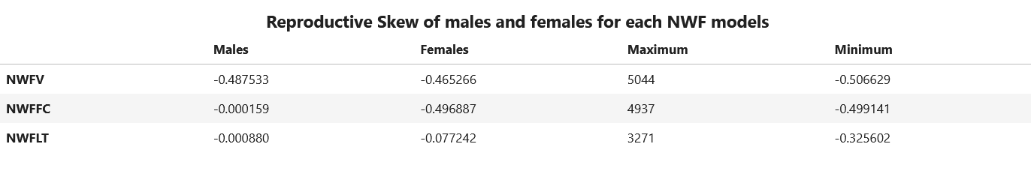


Intrinsic Reproductive Skew
N : Number of sampled individuals R : Total number of Offsprings of all the individuals T : Total time of exposure of all the individuals r : Number of offsprings of every individual t : Time of exposure of every individual
Reproductive Skew estimator :
The multinomial index: a robust measure of reproductive skew, Ross (2020)
$$M\left(r, t\right)= \check{M}\left(r , t\right)−E\left[\check{M}\left(X , t\right)\right]$$
$$\check{M}\left(r, t\right)=\frac{N}{R^{2}} \sum_{i=1}^{N}{{\left(ri−\overline{ri}\right)}^{2}}$$
$$X \sim Multinomial \left(R , \frac{t}{T}\right)$$
28

Slide 38
Intrinsic Reproductive Skew
N : Number of sampled individuals R : Total number of Offsprings of all the individuals T : Total time of exposure of all the individuals r : Number of offsprings of 1 individual t : Time of exposure of 1 individual
Reproductive Skew estimator :
The multinomial index: a robust measure of reproductive skew, Ross (2020)
$$M\left(r, t\right)= \check{M}\left(r , t\right)−E\left[\check{M}\left(X , t\right)\right]$$
$$\check{M}\left(r, t\right)=\frac{N}{R^{2}} \sum_{i=1}^{N}{{\left(ri−\overline{ri}\right)}^{2}}$$
$$X \sim Multinomial \left(R , \frac{t}{T}\right)$$
Low variance Distribution
28

Slide 39
Intrinsic Reproductive Skew
N : Number of sampled individuals R : Total number of Offsprings of all the individuals T : Total time of exposure of all the individuals r : Number of offsprings of 1 individual t : Time of exposure of 1 individual
Reproductive Skew estimator :
The multinomial index: a robust measure of reproductive skew, Ross (2020)
$$M\left(r, t\right)= \check{M}\left(r , t\right)−E\left[\check{M}\left(X , t\right)\right]$$
$$\check{M}\left(r, t\right)=\frac{N}{R^{2}} \sum_{i=1}^{N}{{\left(ri−\overline{ri}\right)}^{2}}$$
$$X \sim Multinomial \left(R , \frac{t}{T}\right)$$
Multinomial Distribution
28

Slide 40
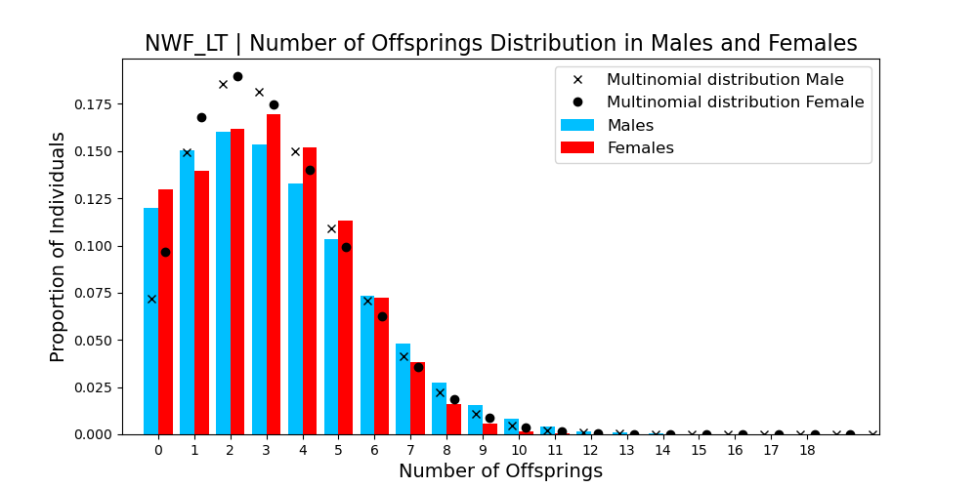
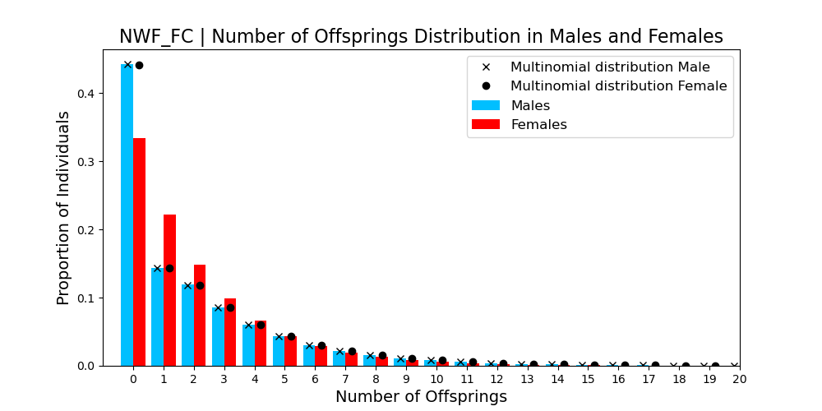
Number of Offsprings
29
AGE

Slide 41
Reference Models
NWF models nucleotid diversity is lower than WF model one
NWF_FC has a X-to-A ratio higher than expected because of random mating
NWF_LT has a X-to-A ratio higher than expected because of random mating and age structure
=> We keep NWF_LT as a reference
30

Slide 42
Reference Models
AGE
=> But Problem on NWF_LT
31
Notes:
- NWF models nucleotid diversity are lower than WF model one
- NWF_FC has a X-to-A ratio higher than expected because of random mating
- NWF_LT has a X-to-A ratio higher than expected because of random mating and age structure

Slide 43
III. Results
32
Notes:
Internship
Title
Intro Pi

Slide 44
A. Males Reproductive Skew
33

Slide 45
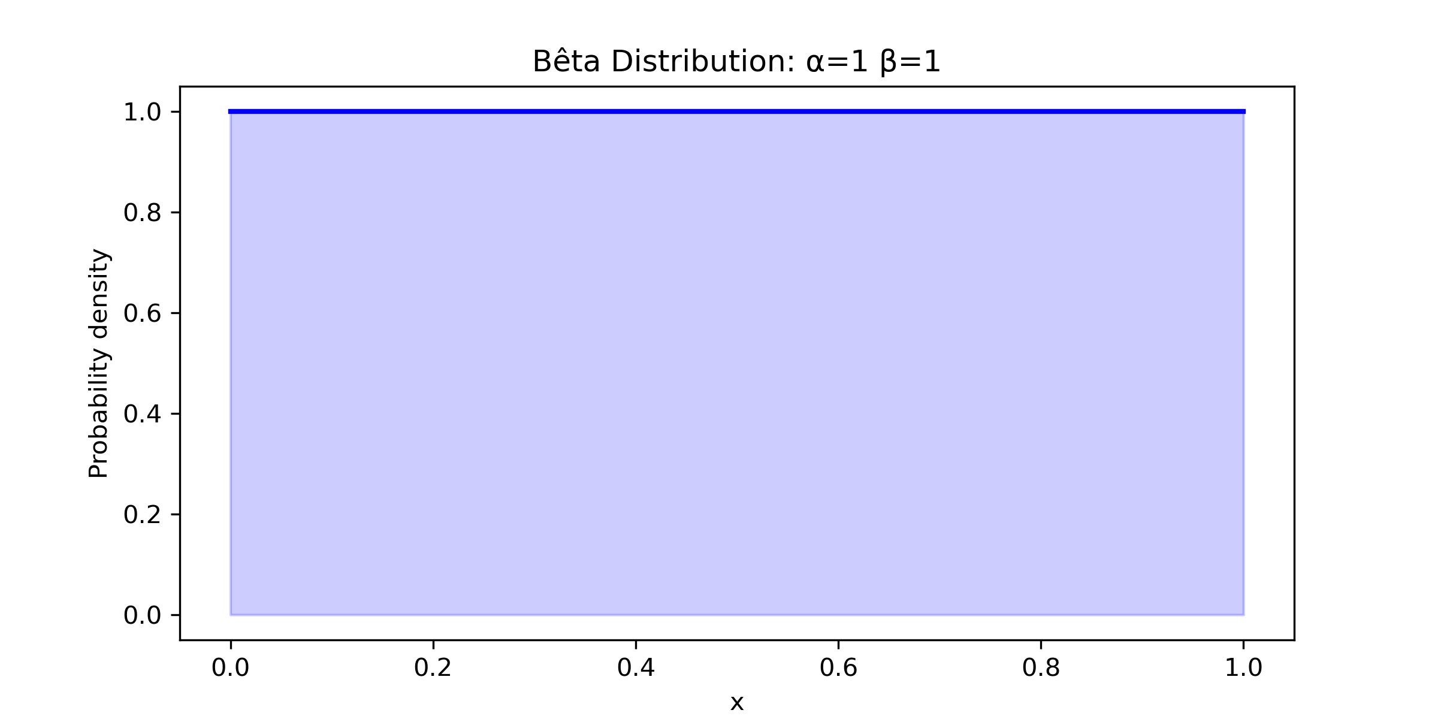
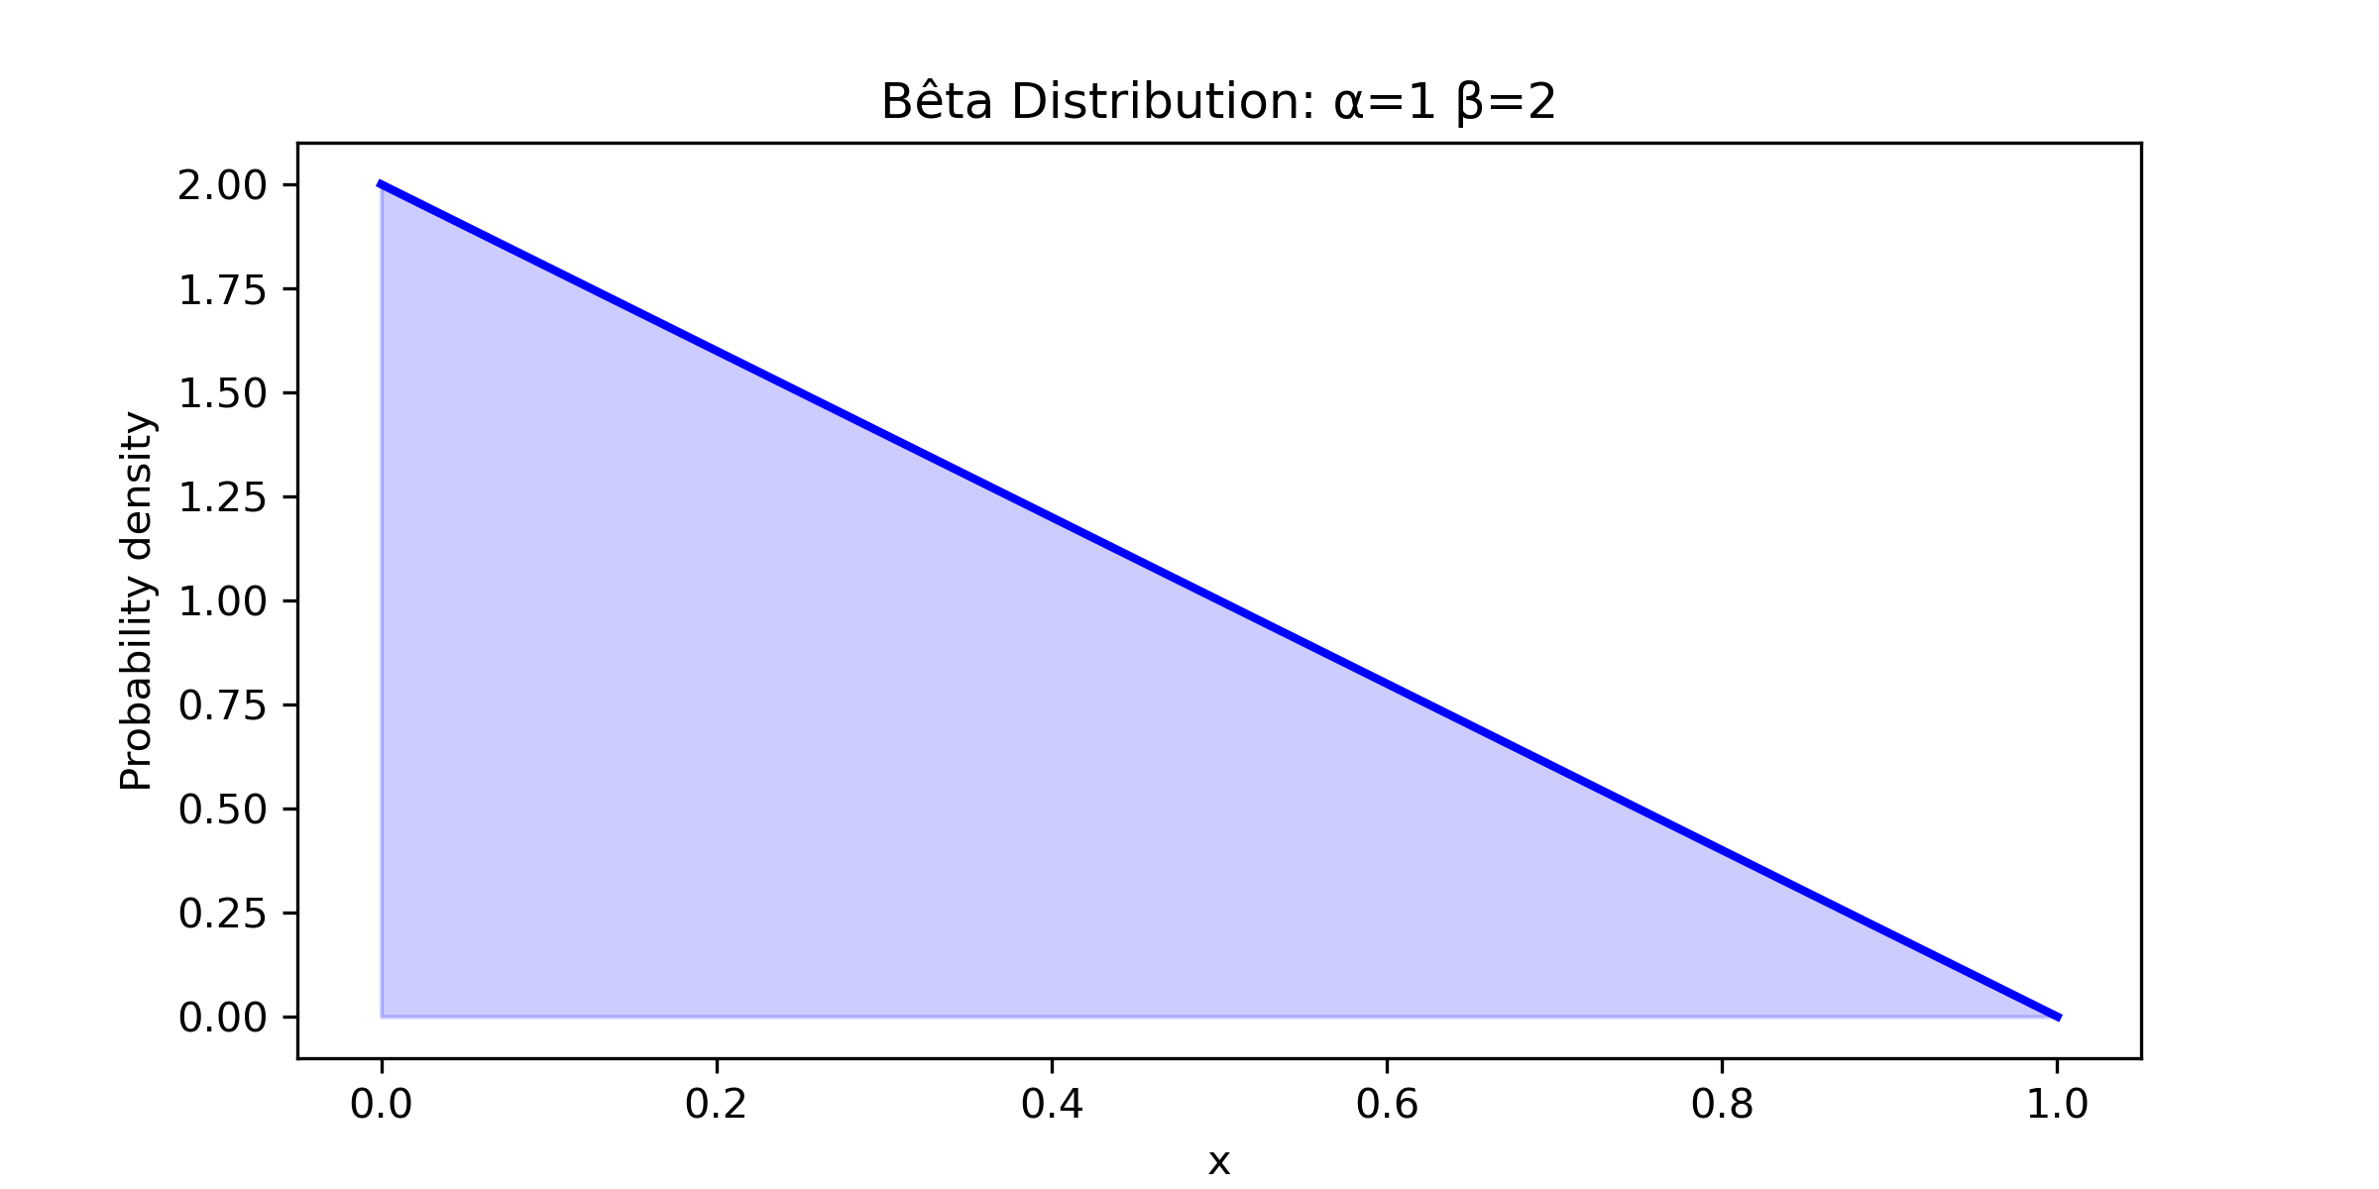
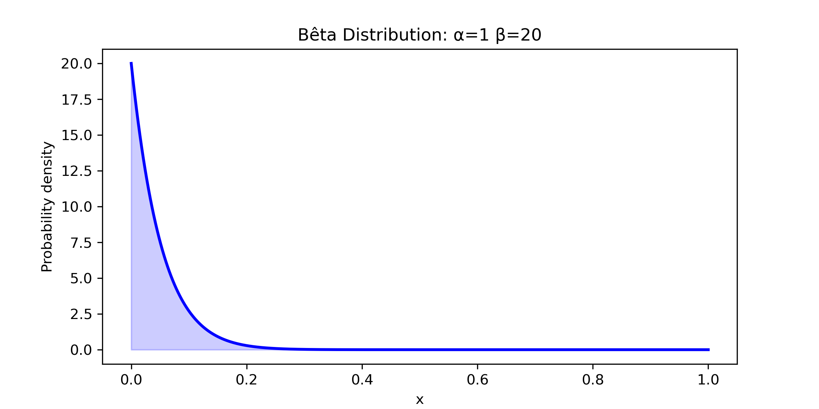
Reproductive Skew
Every males gets a random Ranking value between 0 and 1
Rank determine the relative weight of the male in the reproduction following a beta distribution
Females choose a male if their reproduction is successful
34

Slide 46

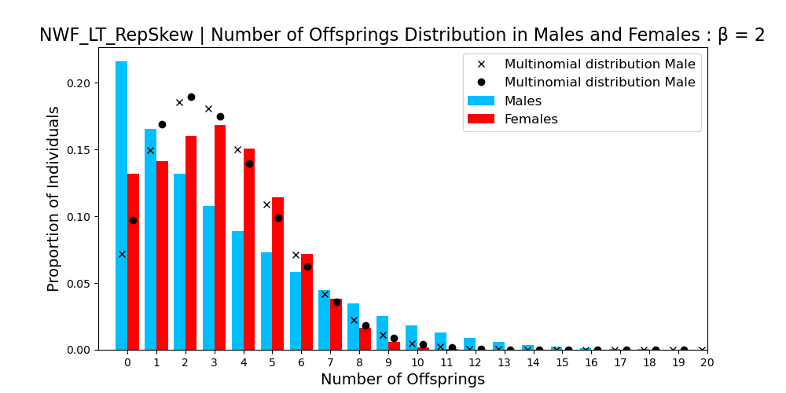
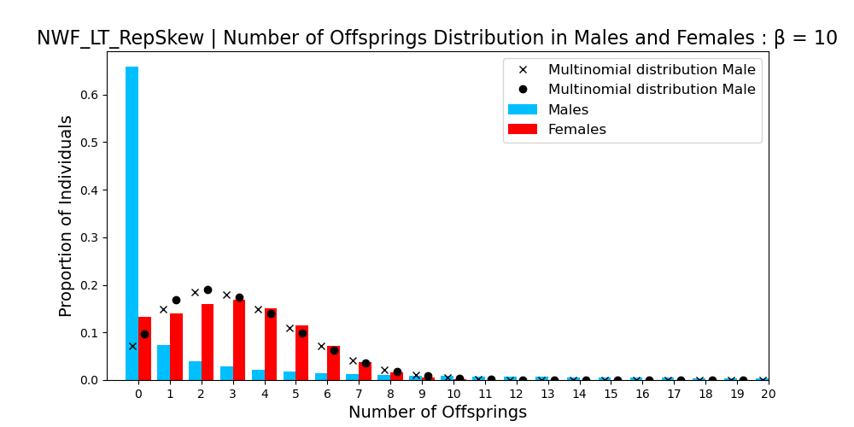
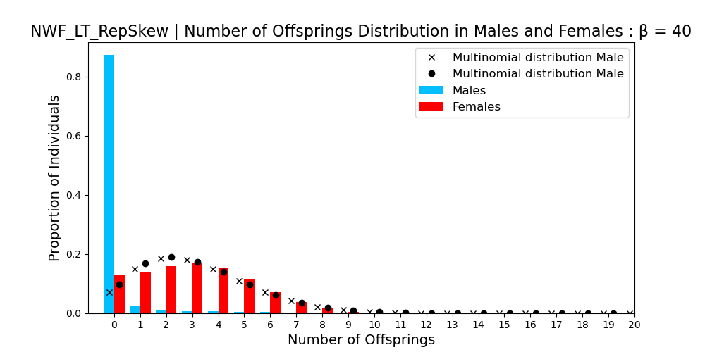
Reproductive Skew
AGE
35

Slide 47
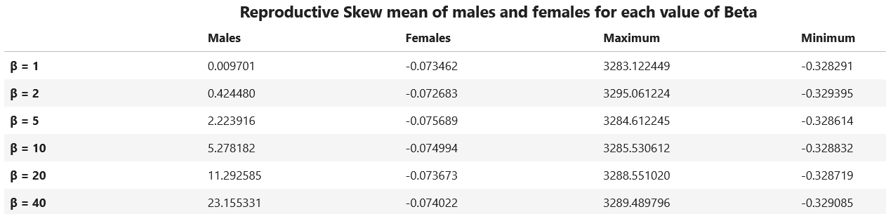
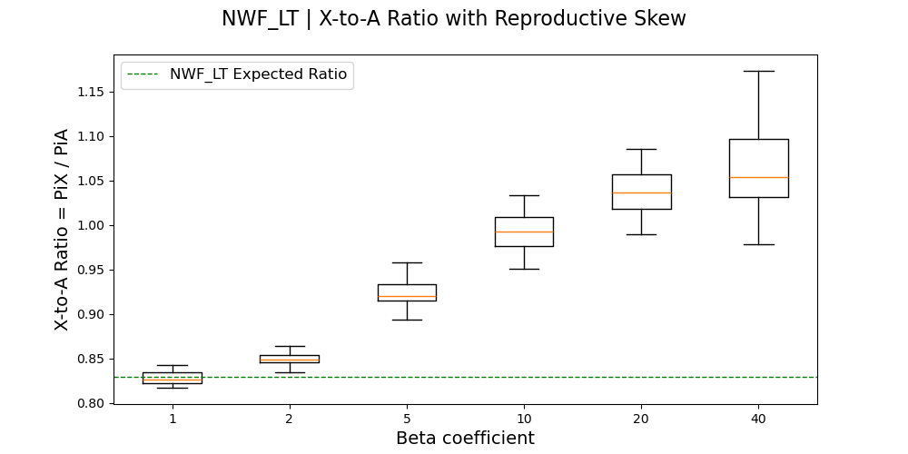
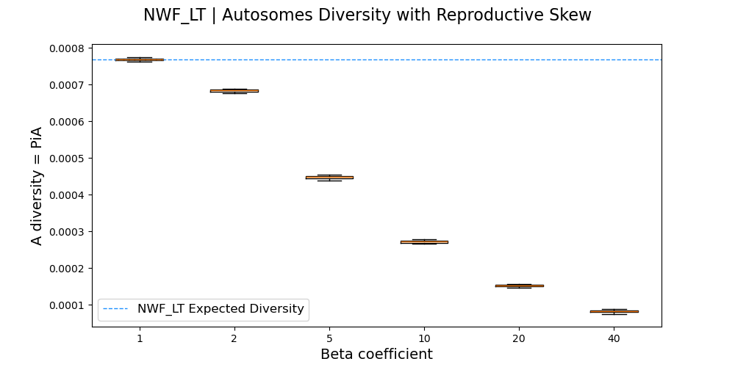
Reproductive Skew
AGE
36

Slide 48
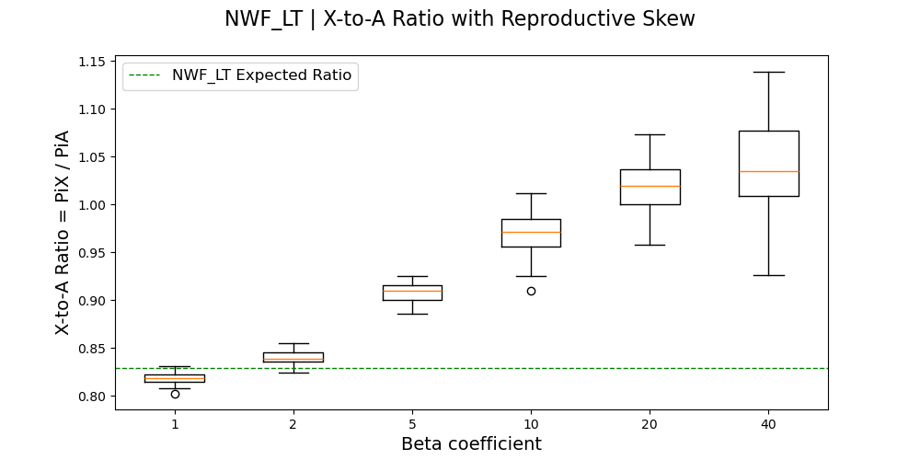
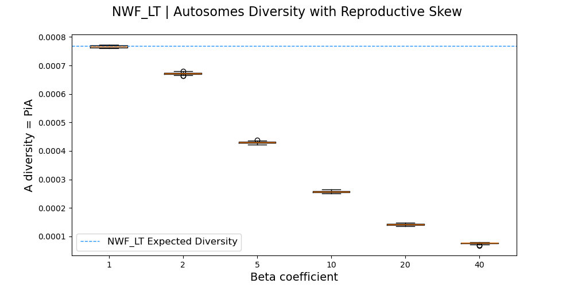
Reproductive Skew
X-to-A ratio increases when the Reproductive Skew in Males increases
In Amboseli Baboons, β might be between 2 and 5
37

Slide 49
B. Males Migration
38

Slide 50
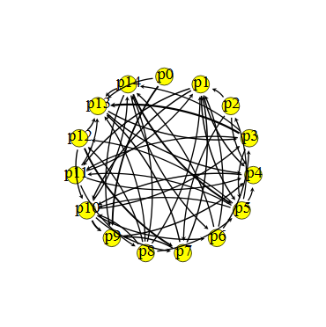
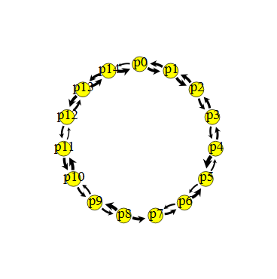
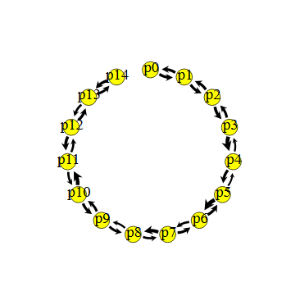
Migration
Division of the population :
-> 15 subpopulations
-> 50 individuals per subpopulations
Males have a probability to migrate every years (when adult)
3 migrations modes :
STAR
CIRCLE
STEPPING STONE
39

Slide 51
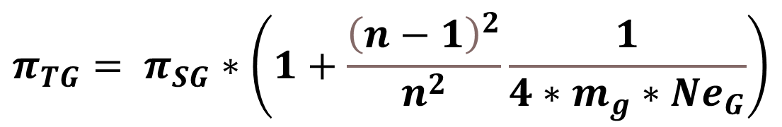
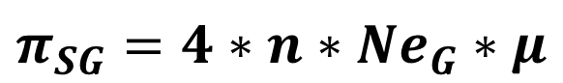
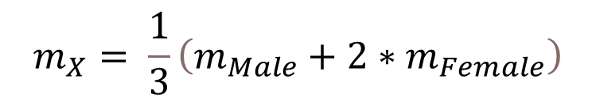
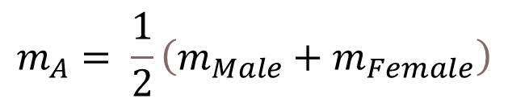
Migration
Genetic Diversity Estimation :
Effective Population Size and Population Subdivision in Demographically Structured Populations, Laporte, Charlesworth 2002
$$π_{SG}=4∗n∗{Ne}_{G}∗μ$$
For one subpopulation
$$π_{TG}= π_{SG}∗\left(1+\frac{{\left(n−1\right)}^{2}}{n^{2}}\frac{1}{4∗m_{g}∗{Ne}_{G}}\right)$$
For the whole meta-population
$$m_{X}= \frac{1}{3}\left(m_{Male}+2∗m_{Female}\right)$$
$$m_{A}= \frac{1}{2}\left(m_{Male}+m_{Female}\right)$$
40

Slide 52
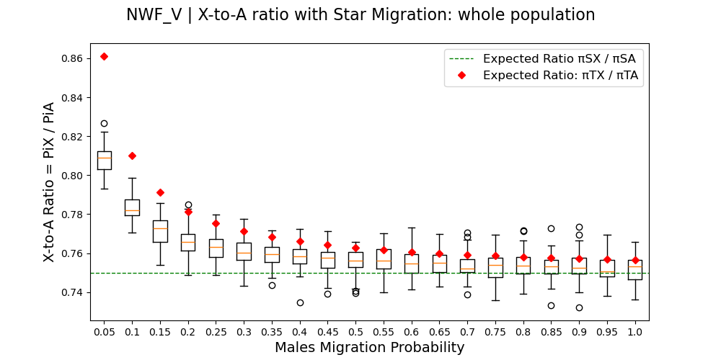
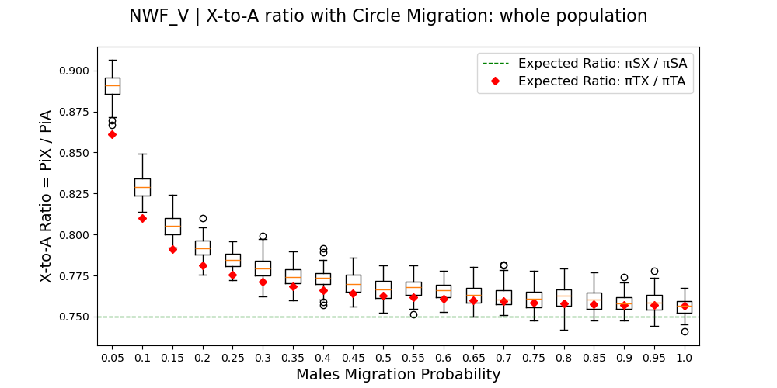
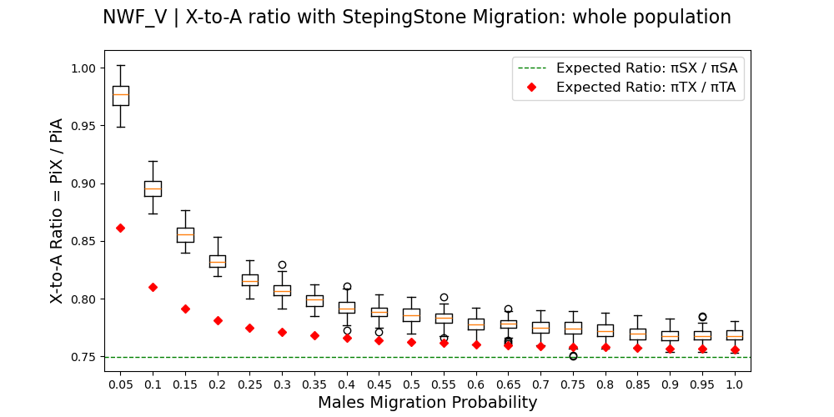
Migration: NWF_V whole Population
41

Slide 53
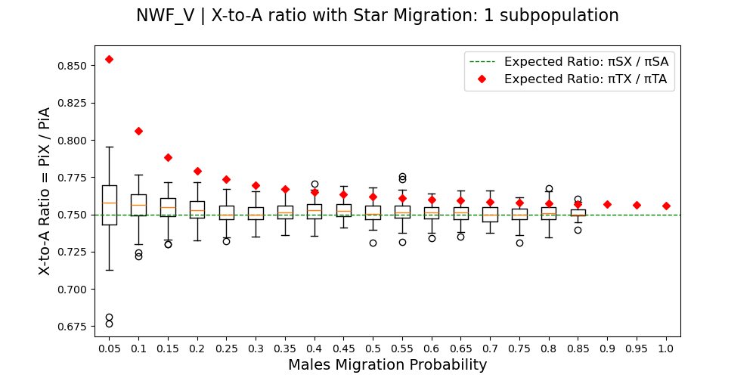


Migration: NWF_V one SubPopulation
42

Slide 54



Migration: NWF_LT whole Population
AGE
43

Slide 55
Migration
X-to-A ratio decreases when the migration probability increases
In Amboseli, every males migrate
Males only Migration does not strongly change the X-to-A ratio
44

Slide 56
Migration: NWF_V One SubPopulation
=> The X-to-A ratio decreases in diverged populations
45

Slide 57
C. Hybridization Without Selection
46

Slide 58
Hybridization
Simulations in 3 Periods:
1) One population (P0) of 750 individuals for 60000 Ticks
2) Division in two isolated populations (P0 and P1) for a tunable time
3) 1 Migration of males from P1 to P0 and Drift of P0 for 30000Ticks
P0
P0
P0
P0
P0
P1
P1
Burn-in
Separation
Divergence
Hybridization
Drift
T I M E
47

Slide 59




Hybridization 10 Migrants
AGE
48

Slide 60




Hybridization 100 Migrants
AGE
49

Slide 61
Hybridization
Hybridization with male migration decreases the X-to-A ratio
The more diverged populations are, the stronger the effect is
50

Slide 62
Hybridization
Selection against admixture and gene regulatory divergence in a long-term primate field study, Vilgalys & al (2022)
Genetic structure in a dynamic baboon hybrid zone corroborates behavioural observations in a hybrid population,
Charpentier & al (2012)
In Amboseli: - Hybridization occurred several times since 1980, with low number of migrants - The time of divergence is around 1,5 million years
51

Slide 63
D. Selection
52

Slide 64
Background Selection
Background Selection = loss of diversity due to negative selection against deleterious mutations
Deleterious mutations only on X :
- Selective Coefficient following a gamma distribution (γ = 1)
- Proportion of Deleterious Mutations
Mutations Rate : 5e-7 mut.nuceotide⁻¹.tick⁻¹
53

Slide 65

Selection : X-to-A Ratio
AGE
54

Slide 66

Selection : X Diversity
AGE
55

Slide 67

Selection : A Diversity
AGE
56

Slide 68

Selection : Population Size
AGE
57

Slide 69
Selection
The more deleterious mutations are, the more the X-to-A ratio is decreased
The higher the deleterious mutations proportion is, the more the X-to-A ratio is decreased
Selection decreases also the population size
58

Slide 70
IV. Conclusion
61
Notes:
Internship
Title
Intro Pi

Slide 71

Forces and Diversity
2 Sex-biased processes affect the X-to-A ratio:
Reproductive Skew in males increases it
Hybridization decreases it
Selection on X decreases the ratio
62

Slide 72
Present Work Limits
Population Rescaling
Burn-in Period changes with different processes
Missing some forces on the X-to-A ratio
Lack of Data for field study–informed Modeling
63

Slide 73
Next Steps
Keep Using SLiM
Many forces in same simulations :
- Reproductive skew Vs Selection - Hybridization Vs Selection
New assumptions to simulate forces
64

Slide 74



Thank You !!!
The PrimEvo Department for the welcoming !
My Internship advisors :
Iker Rivas-Gonzalez
Jenny Tung
Pierre Gerard
65
Notes:
Internship
Title
Intro Pi

Slide 75
V. Annexes
Notes:
Internship
Title
Intro Pi

Slide 76

Mind Map Simulations
Notes:
Internship
Title
Intro Pi

Slide 77




WF : Number of Ticks
Notes:
Internship
Title
Intro Pi

Slide 78


Life Tables
AGE
Notes:
Internship
Title
Intro Pi

Slide 79




Sex Ratio
AGE
Notes:
Internship
Title
Intro Pi

Slide 80


Sex Ratio
AGE
Notes:
Internship
Title
Intro Pi

Slide 81


Intrinsic Reproductive Skew Parameters NWF
AGE
Notes:
Internship
Title
Intro Pi

Slide 82



Rep Skew NWF_LT
AGE
Notes:
Internship
Title
Intro Pi

Slide 83






Rep Skew NWF_LT
AGE
Beta | Noff Max
1 | 20
2 | 29
5 | 51
10 | 83
20 | 162
40 | 294
Notes:
Internship
Title
Intro Pi

Slide 84



Rep Skew NWF_LT Decrease
AGE
Notes:
Internship
Title
Intro Pi

Slide 85



Rep Skew NWF_LT Decrease
AGE
Notes:
Internship
Title
Intro Pi

Slide 86




Rep Skew NWF_LT Decrease
AGE
Notes:
Internship
Title
Intro Pi

Slide 87



Rep Skew NWF_LT SubPop
AGE
Notes:
Internship
Title
Intro Pi

Slide 88



Rep Skew NWF_LT SubPop
AGE
Notes:
Internship
Title
Intro Pi

Slide 89



Rep Skew NWF_LT SubPop
AGE
Notes:
Internship
Title
Intro Pi

